Slide 1

Working with Audio Part 3 Whisper (Transcription)

Slide 2
What We Will Cover
Understanding Whisper (Speech-to-Text)
Transcription
Segments and Words
Response Formats
Prompting
Temperature
Passing the Output

Slide 3
Understanding Whisper Speech-to-Text

Slide 4


Whisper (Speech-to-Text)
Whisper
(Speech-to-Text)

Slide 5
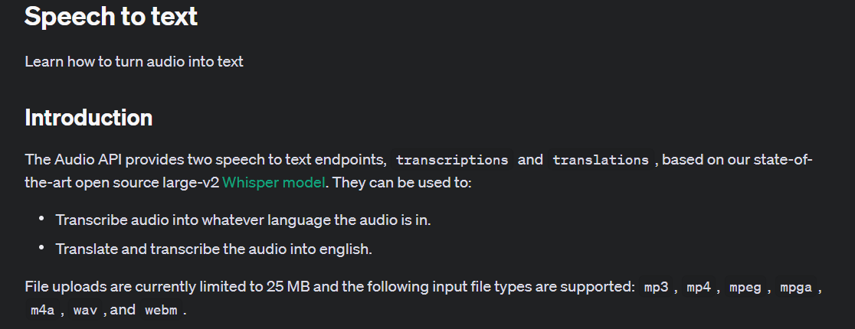
Notes:
https://platform.openai.com/docs/guides/speech-to-text/speech-to-text

Slide 6
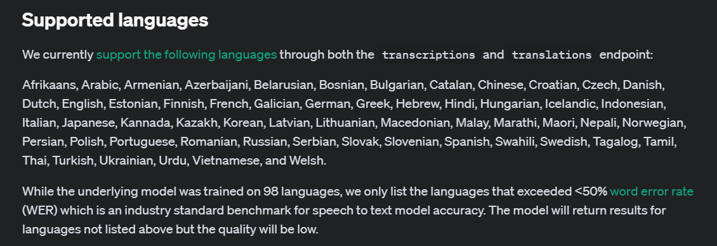
Notes:
https://platform.openai.com/docs/guides/speech-to-text/supported-languages

Slide 7
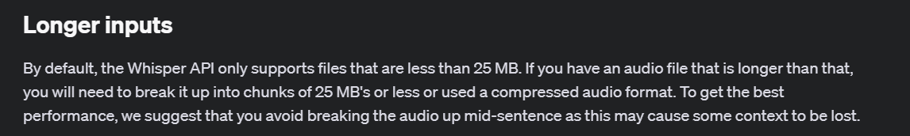
Notes:
https://platform.openai.com/docs/guides/speech-to-text/longer-inputs

Slide 8
Transcription

Slide 9
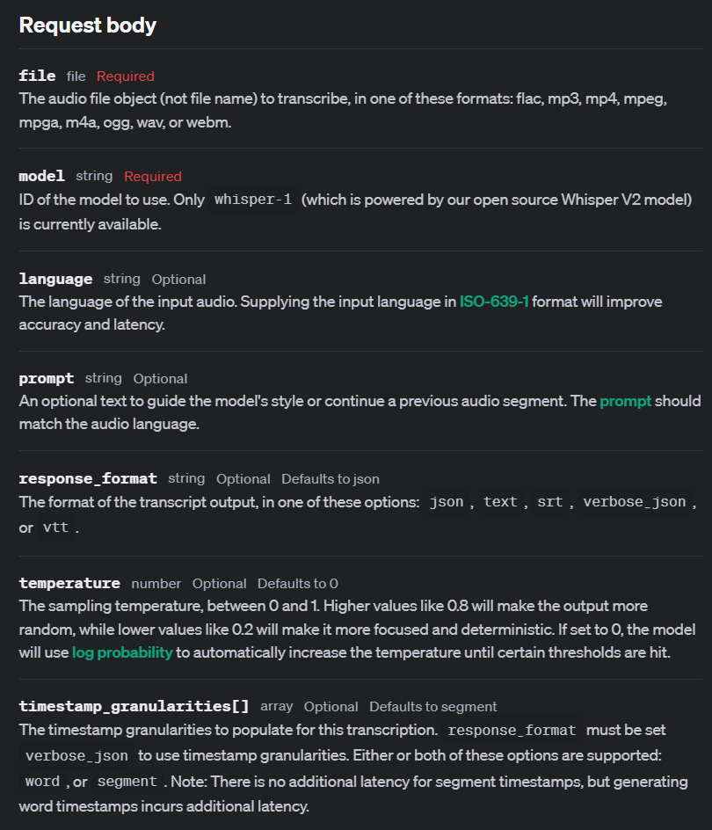

Slide 10
Demo: Simple Transcription
audio_file= open("./artifacts/FDR_pearlharborspeech_64kb.mp3", "rb")
transcription = client.audio.transcriptions.create(
model="whisper-1",
file=audio_file
)
print(transcription.text)

Slide 11
Demo: Transcription with All Parameters
# Create a transcription of the audio file
audio_file = open("./artifacts/fdr_speech.mp3", "rb")
transcript = client.audio.transcriptions.create(
model="whisper-1",
file=audio_file,
language="en",
prompt="Transcribe the following audio file.",
response_format="json",
temperature=0.0,
timestamp_granularities=["segment"],
)

Slide 12



Notes:
https://www.youtube.com/channel/UC35ZpwldGw7ZJ5R-2sLijzw

Slide 13

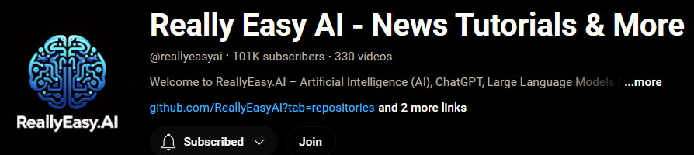
Membership has its privileges
Notes:
https://www.youtube.com/channel/UC35ZpwldGw7ZJ5R-2sLijzw/join

Slide 14
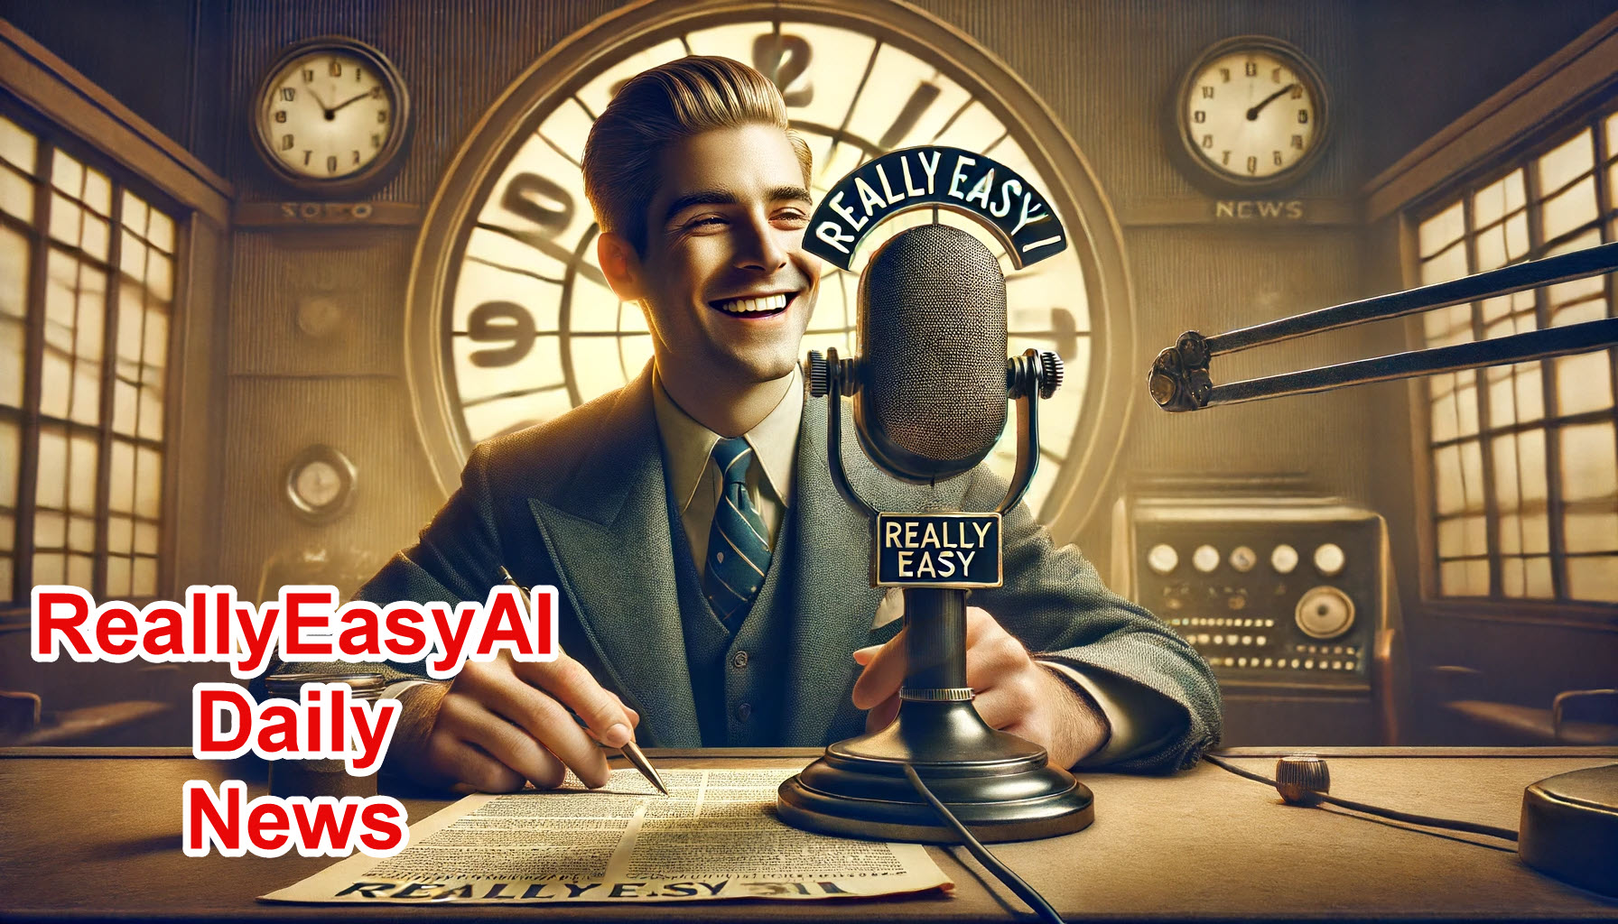
https://www.youtube.com/@AINewsFresh

Slide 15
Segments and Words

Slide 16
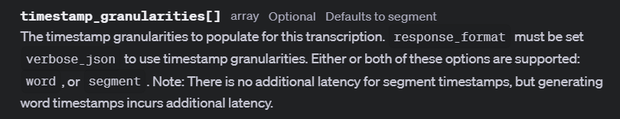
Notes:
https://platform.openai.com/docs/api-reference/audio/createTranscription#audio-createtranscription-timestamp_granularities

Slide 17
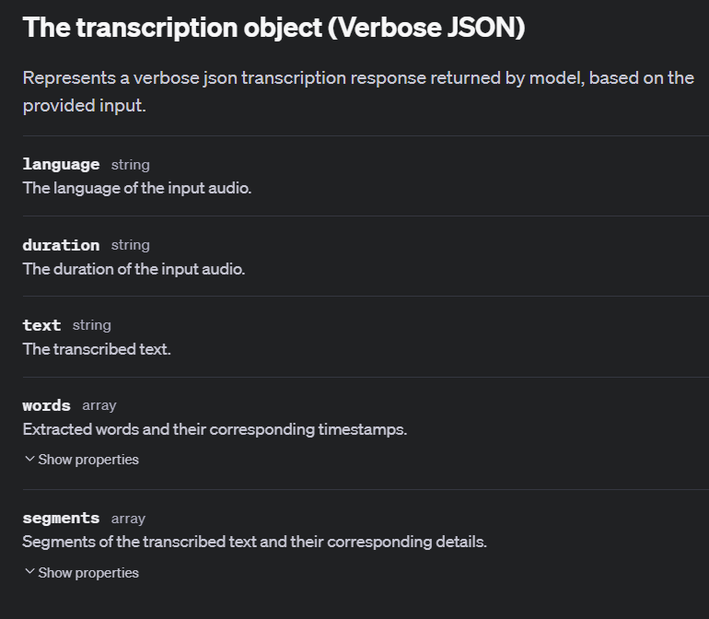
Notes:
https://platform.openai.com/docs/api-reference/audio/verbose-json-object

Slide 18
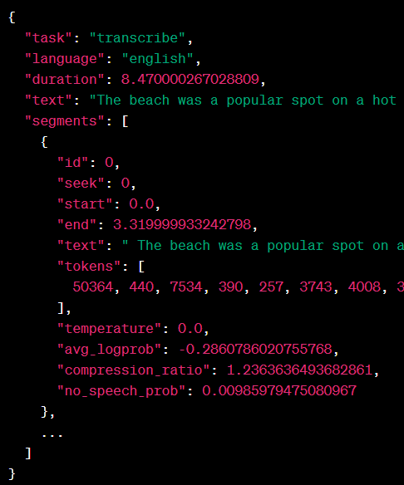
Segment Example

Slide 19
Demo: Segment Timestamps
# Create a transcription of the audio file
audio_file = open("./artifacts/fdr_speech.mp3", "rb")
transcript = client.audio.transcriptions.create(
model="whisper-1",
file=audio_file,
language="en",
prompt="Transcribe the following audio file.",
response_format="verbose_json",
temperature=0.0,
timestamp_granularities=["segment"],
)

Slide 20
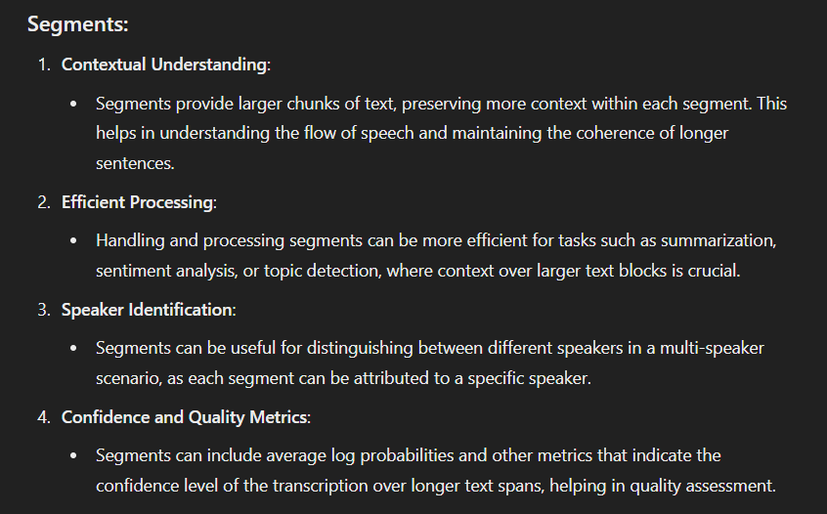
Why Segments?

Slide 21
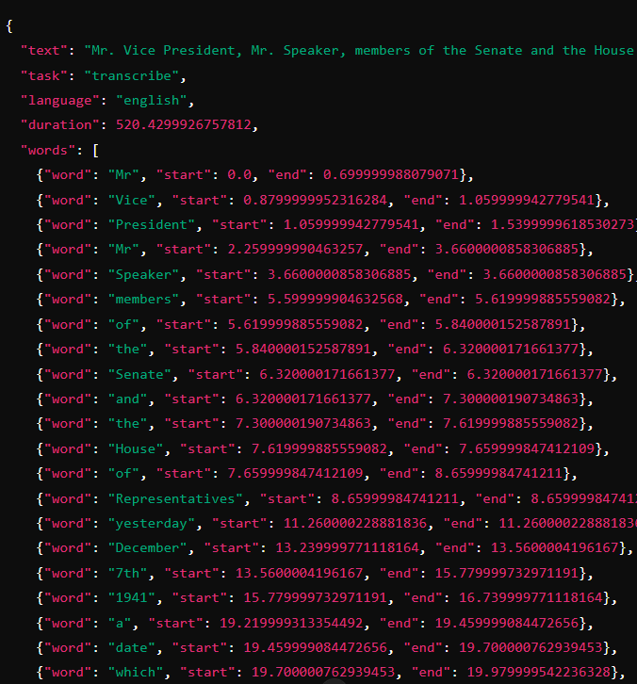
Word Example

Slide 22
Demo: Word Timestamps
# Create a transcription of the audio file
audio_file = open("./artifacts/fdr_speech.mp3", "rb")
transcript = client.audio.transcriptions.create(
model="whisper-1",
file=audio_file,
language="en",
prompt="Transcribe the following audio file.",
response_format="verbose_json",
temperature=0.0,
timestamp_granularities=["word"],
)

Slide 23
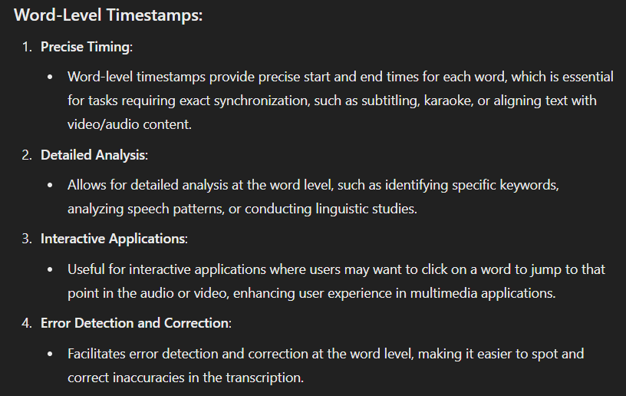
Why Words?

Slide 24
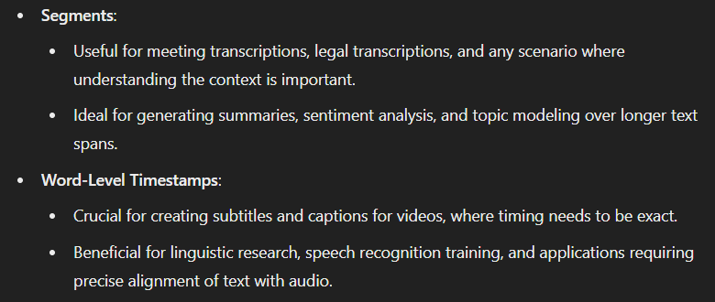
Use Cases

Slide 25
Response Formats

Slide 26
verbose_json

Slide 27
text
Mr. Vice President, Mr. Speaker, members of the Senate and the House of Representatives, yesterday, December 7th, 1941, a date which will live in infamy, the United States of America was suddenly and deliberately attacked by naval and air forces of the Empire of Japan. The United States was at peace with that nation, and at the solicitation of Japan, was still in conversation with its government and its emperor, looking toward the maintenance of peace in the Pacific.

Slide 28
Demo: text format
# Create a transcription of the audio file
audio_file = open("./artifacts/fdr_speech.mp3", "rb")
transcript = client.audio.transcriptions.create(
model="whisper-1",
file=audio_file,
language="en",
prompt="Transcribe the following audio file.",
response_format="text",
temperature=0.0,
timestamp_granularities=["segment"],
)

Slide 29
srt (SubRip Subtitle)
1 00:00:00,000 --> 00:00:10,000
Mr. Vice President, Mr. Speaker, members of the Senate and the House of Representatives,
2 00:00:10,000 --> 00:00:25,500 yesterday, December 7th, 1941, a date which will live in infamy, the United States of
3 00:00:25,500 --> 00:00:35,500 America was suddenly and deliberately attacked by naval and air forces of the Empire of Japan.
4 00:00:35,500 --> 00:00:47,299 The United States was at peace with that nation, and at the solicitation of Japan, was still
5 00:00:47,299 --> 00:00:55,180 in conversation with its government and its emperor, looking toward the maintenance of
6 00:00:55,180 --> 00:01:06,379 peace in the Pacific. Indeed, one hour after Japanese air squadrons had commenced bombing

Slide 30
Demo: srt (SubRip Subtitle) format
# Create a transcription of the audio file
audio_file = open("./artifacts/fdr_speech.mp3", "rb")
transcript = client.audio.transcriptions.create(
model="whisper-1",
file=audio_file,
language="en",
prompt="Transcribe the following audio file.",
response_format="srt",
temperature=0.0,
timestamp_granularities=["segment"],
)

Slide 31
Prompting

Slide 32
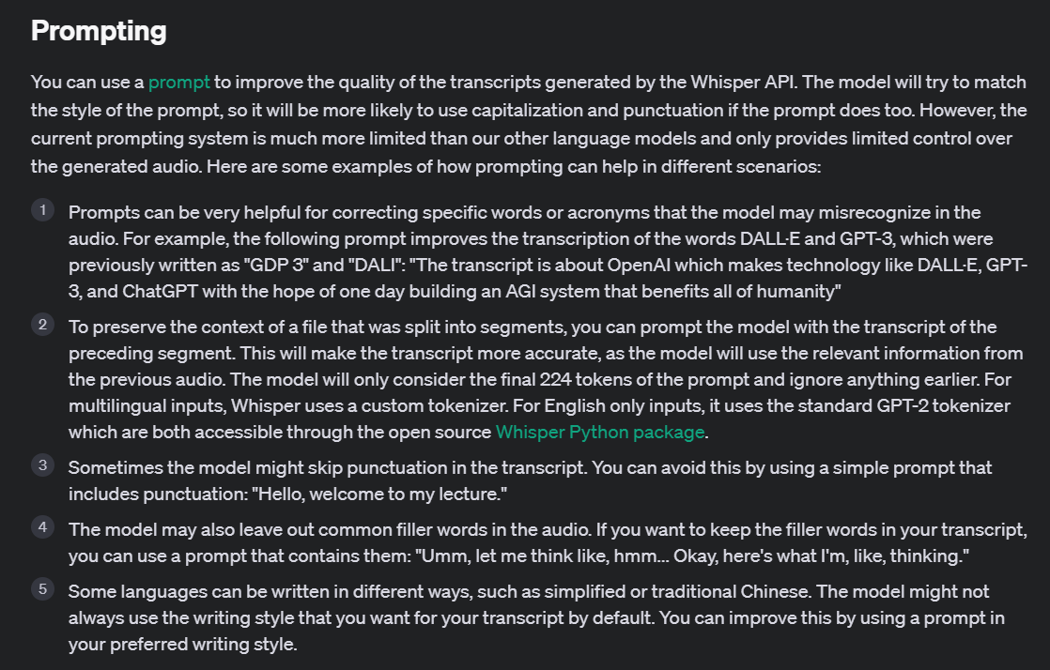
Notes:
https://platform.openai.com/docs/guides/speech-to-text/prompting

Slide 33
Demo: Prompting
# Create a transcription of the audio file
audio_file = open("./artifacts/acronym_audio.mp4", "rb")
transcript = client.audio.transcriptions.create(
model="whisper-1",
file=audio_file,
language="en",
prompt="GPT-4o, GPT-4o mini",
response_format="json",
temperature=0.0,
timestamp_granularities=["segment"],
)

Slide 34
Temperature

Slide 35
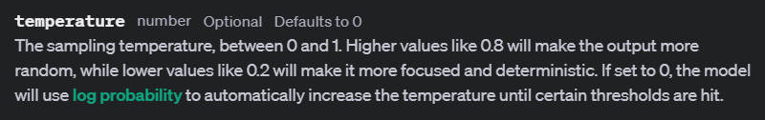
Notes:
https://platform.openai.com/docs/api-reference/audio/createTranscription#audio-createtranscription-temperature

Slide 36
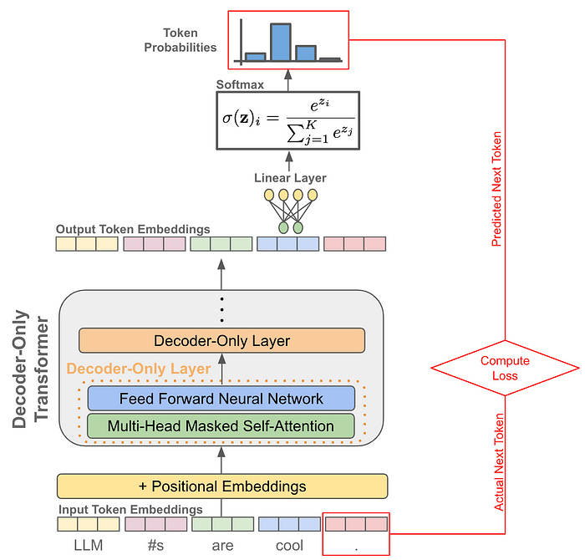
Prediction
Log(Probabilities)

Slide 37
Temperature Examples
Audio Sentence: "Good morning everyone, um, let's get started with our quarterly review. As you can see, the sales figures for Q2 have, uh, significantly improved. However, we still need to address the issues in the supply chain. Any thoughts?"
High Temperature Transcription: "Good morning everyone, let's get started with our quarterly review. The sales figures for Q2 have significantly improved. However, we still need to address the issues in the supply chain. Any thoughts?"(More fluent, less filler words)
Low Temperature Transcription: "Good morning everyone, um, let's get started with our quarterly review. As you can see, the sales figures for Q2 have, uh, significantly improved. However, we still need to address the issues in the supply chain. Any thoughts?" (More literal and detailed)
Dynamic Temperature (0): "Good morning everyone, let's get started with our quarterly review. As you can see, the sales figures for Q2 have significantly improved. However, we still need to address the issues in the supply chain. Any thoughts?"(Balanced, removing unnecessary fillers while maintaining accuracy)

Slide 38
Demo: Using Temperature
# Create a transcription of the audio file
audio_file = open("./artifacts/temperature_audio_test.mp4", "rb")
transcript = client.audio.transcriptions.create(
model="whisper-1",
file=audio_file,
language="en",
prompt="Transcribe the following audio file.",
response_format="json",
temperature=0.1,
)

Slide 39
Passing the Output

Slide 40
Feeding Generated Output to Something Else
Whisper
(Speech-to-Text)
Chat Completion

Slide 41
Demo: Passing the Output
response = client.chat.completions.create(
model="gpt-4o",
temperature=1,
messages=[
{
"role": "system",
"content": "You will be given a transcript of an audio file. Your task is to summarize the text and tell me who is speaking."
},
{
"role": "user",
"content": transcript
}
]
)

Slide 42
